Slide 1


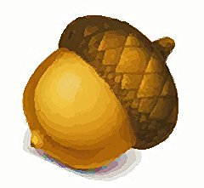
TCC CS 142B Fall 2012
Final Project - Group 4
Team Acorn
Master Programmer: Samuel Hug
GUI Developer and Programmer: Jacob Casperson
Assistant to the Assistant and Report Writer: Dan Massie

Slide 2
TCC CS 142B Fall 2012
Final Project - Group 4
Team Acorn
Why Team Acorn?

Slide 3

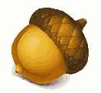
TCC CS 142B Fall 2012
Final Project - Group 4
In 1991, a group of Sun Microsystems engineers led by James Gosling decided to
develop a language for consumer devices (cable boxes, etc.). The project was
code-named Green. They first called their program “Oak”. Yes – This is now JAVA.
-That’s why you nut!

Slide 4
TCC CS 142B Fall 2012
Final Project - Group 4
Proposal: Create a game of pong
Make it larger than life with multiple
players and all the bells and whistles!

Slide 5
TCC CS 142B Fall 2012
Team Project - Group 4
Considerations/Difficulties:
Number of players
Collision detection
Third party libraries
Finding time to collaborate
Different levels of competence

Slide 6
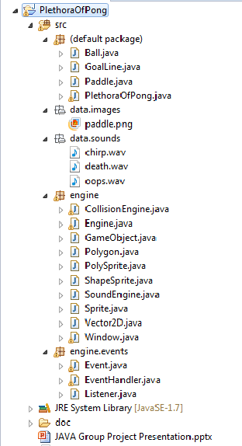
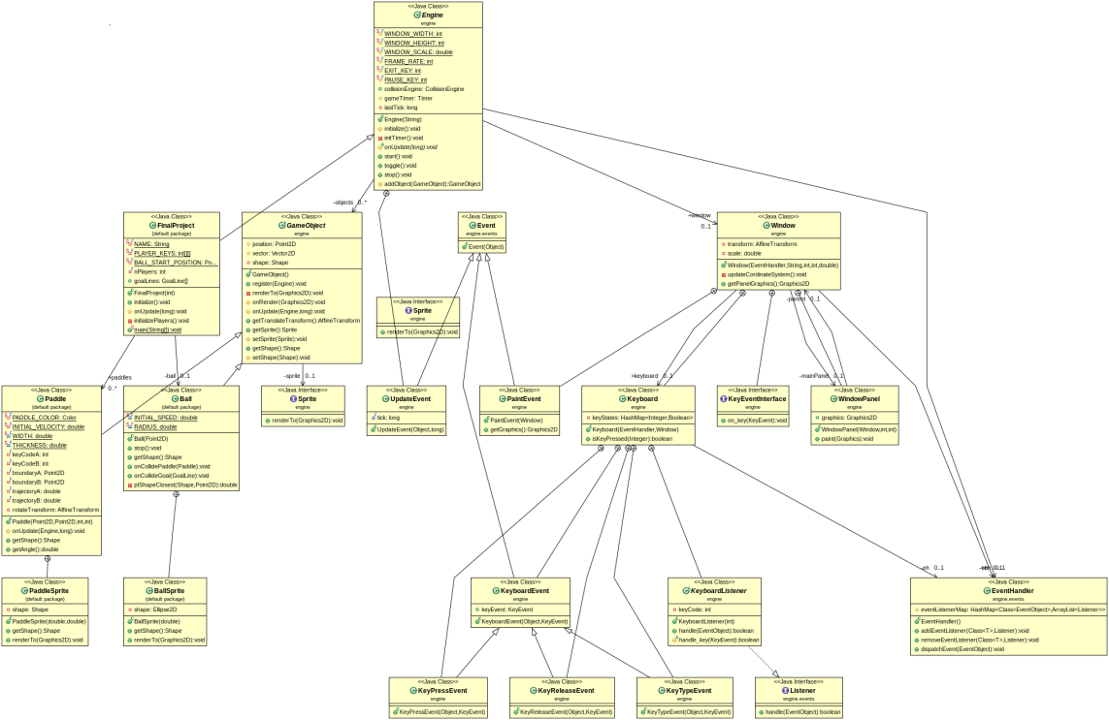
TCC CS 142B Fall 2012
Team Project - Group 4
UML DIAGRAM

Slide 7
TCC CS 142B Fall 2012
Team Project - Group 4
Success and Achievements:
Multi-player pong game that works
Team-work and collaborative sharing
Hardware setup
Collision detection
Multiple balls and GUI interface

Slide 8
TCC CS 142B Fall 2012
UML Diagram
Team Project - Group 4
Lessons Learned:
Start earlier
Define classes and methods as a group
Use source control software
Understand source control software

Slide 9

TCC CS 142B Fall 2012
The greatest oak was once a little nut who held its ground....… -Author Unknown.
Special thanks to:
Professor Meerdink
-Team Acorn

Slide 10
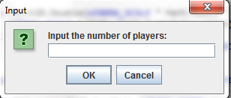
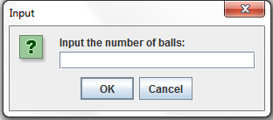
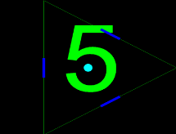
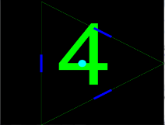
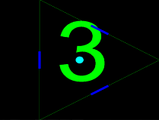
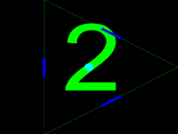
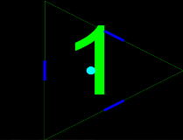
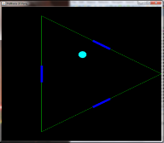
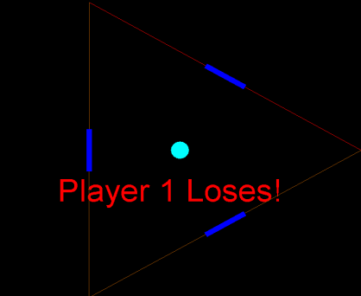
PlethoraOfPong Version 1.02 Beta Release Date 2012_12_10 Game Familiarization
Game Initialization
Count-down to start game
Player 4
(N, M)
Player 4
(N, M)
Player loses game

Slide 11
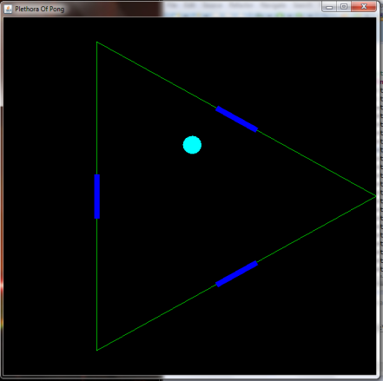
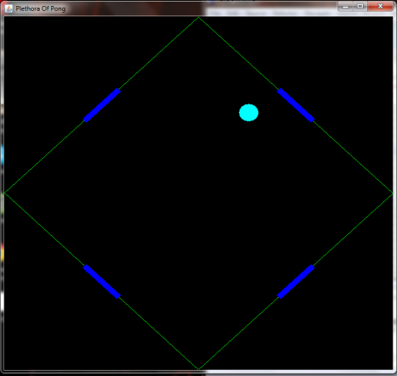
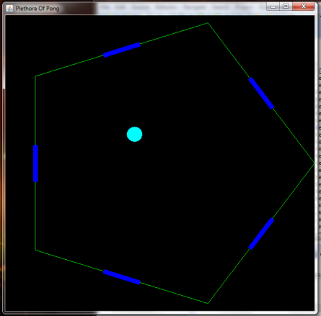
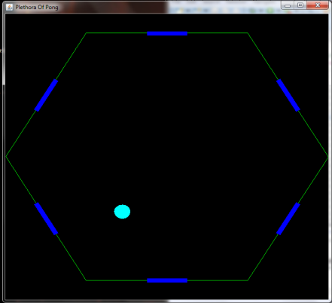
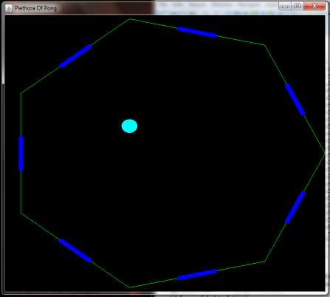
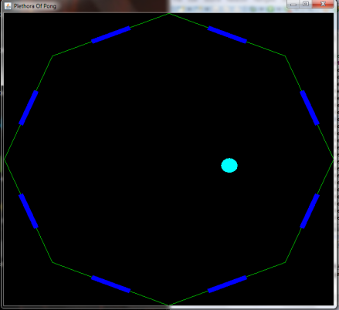
PlethoraOfPong Version 1.02 Beta Release Date 2012_12_10 Keyboard Familiarization
Player Controls
Player 1 | 1 | 2
Player 2 | 9 | 0
Player 3 | Z | X
Player 4 | N | M
Player 5 | Q | W
Player 6 | O | P
Player 7 | C | V
Player 8 | K | L
Player 9 | 3 | 4
Player 10 | 7 | 8
Player 11 | A | S
Player 12 | H | J
Player 13 | D | F
Player 14 | G | H
Player 15 | 5 | 6
Player 16 | E | R
Player 17 | U | I
Player 18 | T | Y
3 Players
4 Players
5 Players
Player 2
(9, 0)
Player 1
(1, 2)
Player 2
(9, 0)
Player 2
(9, 0)
Player 4
(N, M)
Player 1
(1, 2)
Player 1
(1, 2)
Player 3
(Z, X)
Player 5
(Q, W)
Player 3
(Z, X)
Player 3
(Z, X)
Player 4
(N, M)
Player 4
(N, M)
6 Players
7 Players
8 Players
Player 2
(9, 0)
Player 3
(Z, X)
Player 2
(9, 0)
Player 3
(Z, X)
Player 2
(9, 0)
Player 3
(Z, X)
Player 1
(1, 2)
Player 1
(1, 2)
Player 4
(N, M)
Player 1
(1, 2)
Player 4
(N, M)
Player 4
(N, M)
Player 6
(O, P)
Player 7
(C, V)
Player 5
(Q, W)
Player 8
(K, L)
Player 5
(Q, W)
Player 5
(Q, W)
Player 6
(O, P)
Player 6
(O, P)
Player 7
(C, V)

Slide 12
TCC CS 142B Fall 2012
Please feel free to download a free (for now) Beta
Version of PlethoraOfPong version 1.02 at the
following site:
https://github.com/samuelhug/cs_142_final_project
-Team Acorn

